Slide 1
Unit 1
Introduction

Slide 2
Software Engineering
Software Engineering is the science and art of
building significant software systems that are:
  1) on time
  2) on budget
  3) with acceptable performance
  4) with correct operation.

Slide 3
Software Engineering
The economies of all developed nations are
dependent on software.
More and more systems are software controlled.
Software engineering is concerned with theories, methods and tools for professional software development.
Software engineering expenditure represents a
significant fraction of the GNP of developed countries.

Slide 4
Software Costs
Software costs often dominate system costs. The costs of software on a PC are often greater than the hardware cost.
Software costs more to maintain than it does to develop.
Software engineering is concerned with cost-effective software development.

Slide 5
Software Products
Generic products:
  Stand-alone systems which are produced by a development organization and sold on the open market to any customer.
Customized products:
  Systems which are commissioned by a specific customer and developed specially by some contractor.

Slide 6
Software Product Attributes
Maintainability
Dependability
Efficiency
Usability

Slide 7
Importance of Product Characteristics
The relative importance of these characteristics depends on the product and the environment in which it is to be used.
In some cases, some attributes may dominate
  In safety-critical real-time systems, key attributes may be dependability and efficiency.
Costs tend to rise exponentially if very high levels of any one attribute are required.

Slide 8
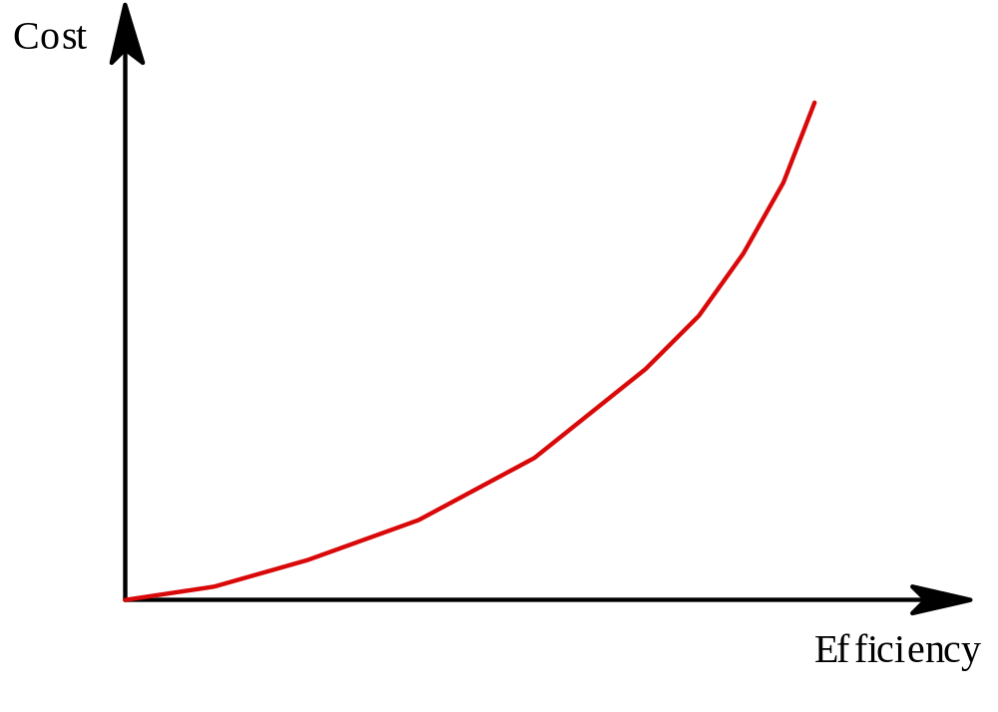
Efficiency Costs

Slide 9
The Software Process
Structured set of activities required to develop a
software system
  Specification
  Design
  Validation
  Evolution
Activities vary depending on the organization
and the type of system being developed.
Must be explicitly modeled if it is to be
managed.

Slide 10
Engineering Process Model
Specification: Set out the requirements and
constraints on the system.
Design: Produce a model of the system.
Manufacture: Build the system.
Test: Check the system meets the required
specifications.
Install: Deliver the system to the customer and
ensure it is operational.
Maintain: Repair faults in the system as they
are discovered.

Slide 11
Software Engineering is Different
Normally, specifications are incomplete.
Very blurred distinction between specification,
design and manufacture.
No physical realization of the system for testing.
Software does not wear out - maintenance
does not mean component replacement.

Slide 12
Software engineering ethics
Software engineering involves wider responsibilities than simply the application of technical skills.
Software engineers must behave in an honest and ethically responsible way if they are to be respected as professionals.
Ethical behaviour is more than simply upholding the law but involves following a set of principles that are morally correct.

Slide 13
Software Process Models
Process model (Life-cycle model) -steps through which the product progresses
  Requirements phase
  Specification phase
  Design phase
  Implementation phase
  Integration phase
  Maintenance phase
  Retirement

Slide 14
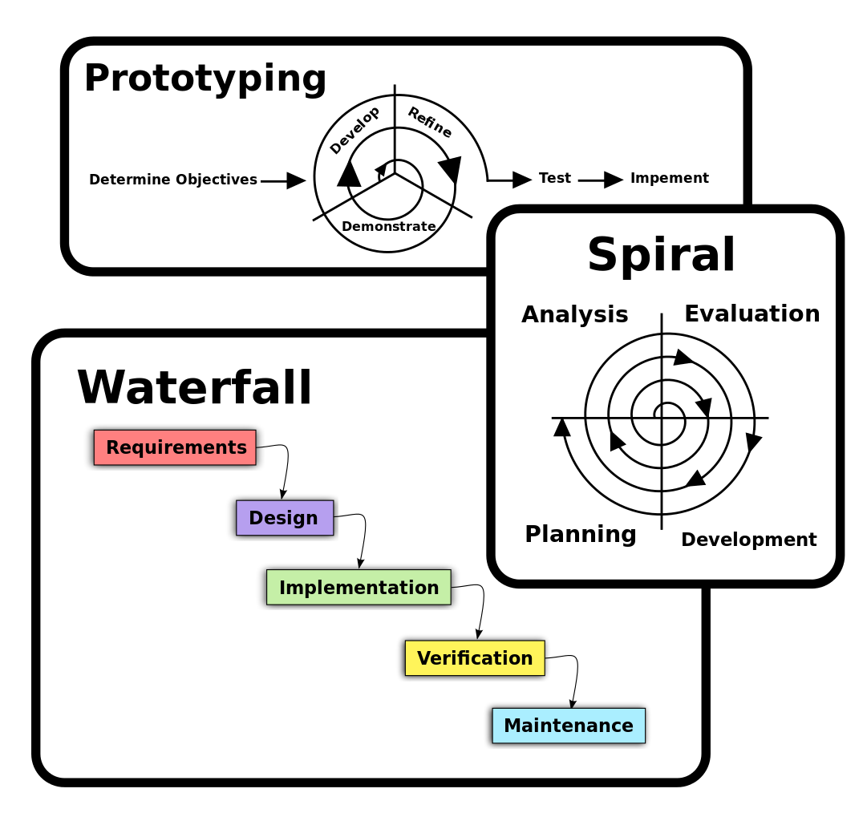
Software Process Models

Slide 15
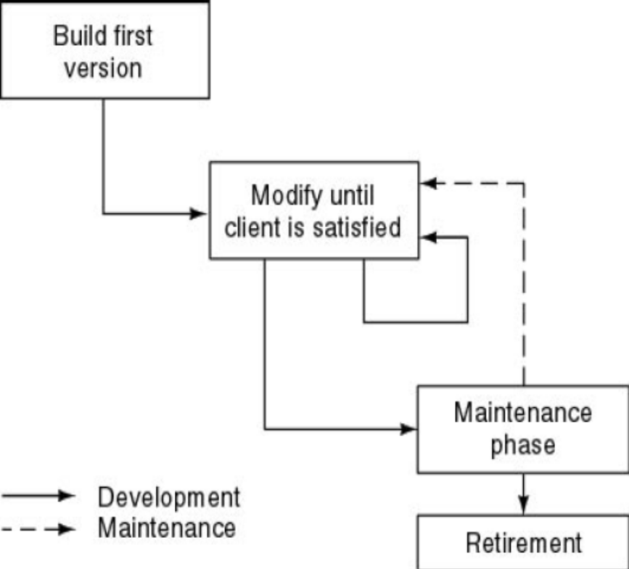
Build-and-Fix Model
Problems
  No specifications
  No design
Totally unsatisfactory
  High cost
  Difficult maintenance

Slide 16
Waterfall Model
The waterfall model is a sequential design process in which progress is seen as flowing steadily downwards (like a waterfall) through the phases of SDLC.
Waterfall model is an example of a Sequential model. In this model, the software development activity is divided into different phases and each phase consists of a series of tasks and has different objectives.
Waterfall model is the pioneer of the SDLC processes.
Characterized by:
  Feedback loops
  Documentation-driven

Slide 17
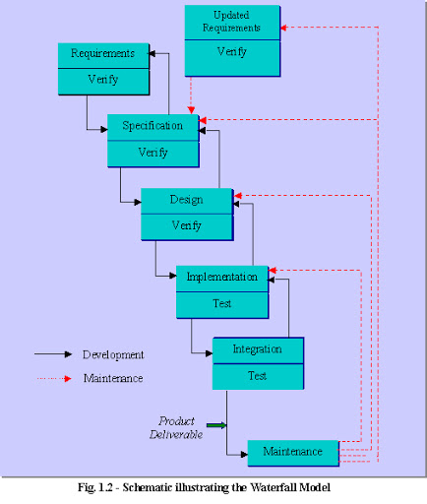

Slide 18
Waterfall Model (contd.)
Advantages
  Enforces disciplined approach
    Documentation for each phase
    Products of each phase checked by SQA group
  Maintenance is easier
    Every change reflected in the relevant documentation
Disadvantages
  Working version of the software will not be available until late in the project time-span
  Specifications are long, detailed, written in a style unfamiliar to the client
  “Blocking states” –some project team members must wait for other team members to complete dependent tasks

Slide 19
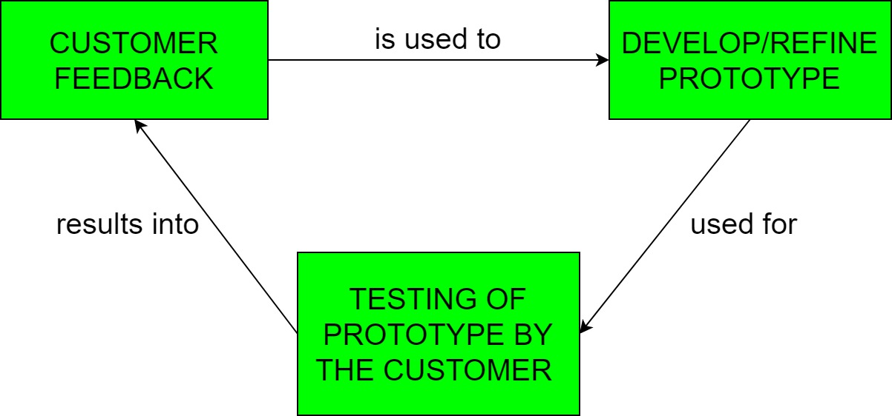
Rapid Prototyping Model
Prototyping is defined as the process of developing a working replication of a product or system that has to be engineered.
It offers a small scale replica of the end product and is used for obtaining customer feedback as described below:

Slide 20
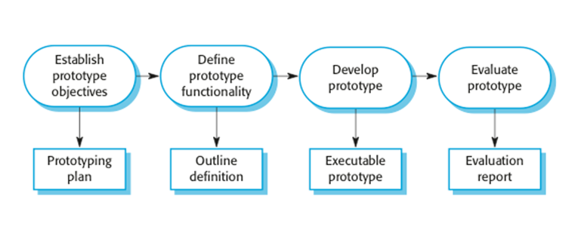
Rapid Prototyping Model (contd.)

Slide 21
Rapid Prototyping Model (contd.)
Rapid prototype characteristics:
  Used in the requirements phase
  Evaluated by the customer/user
  Then, it is discarded -do not turn into product
Rapid prototyping model is not proven and has its own problems
  Possible solution
    Rapid prototyping for defining requirements
    Waterfall model for rest of life cycle

Slide 22
Incremental Model
Incremental Model is a process of software development where requirements are broken down into multiple standalone modules of software development cycle.
Each iteration passes through the requirements, design, coding and testing phases.
Typical product takes from 5 to 25 builds (iterations).

Slide 23
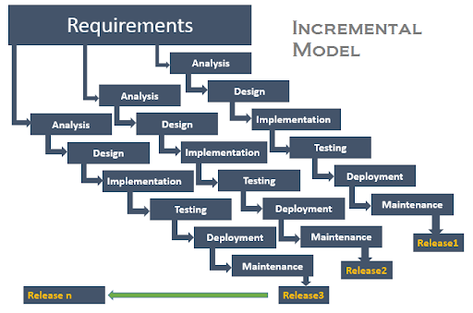
Incremental Model (contd.)

Slide 24
Incremental Model (contd.)
Waterfall and rapid prototyping models
  Deliver complete product at the end
Incremental model
  Deliver portion of the product at each stage
Advantages
  The software will be generated quickly during the software life cycle
  It is flexible and less expensive to change requirements and scope
  Throughout the development stages changes can be done
  This model is less costly compared to others
  A customer can respond to each building
  Errors are easy to be identified

Slide 25
Incremental Model (contd.)
Disadvantages:
  It requires a good planning designing
  Problems might arise due to system architecture as not all requirements collected up front for the entire software lifecycle
  Each iteration phase is rigid and does not overlap each other
  Correcting a problem in one unit requires correction in all the units and consumes a lot of time

Slide 26
When to use Incremental models?
Requirements of the system are clearly understood
When demand for an early release of a product arises
When software engineering team are not very well skilled or trained
When high-risk features and goals are involved
Such methodology is more in use for web application and product based companies

Slide 27
Spiral Model
The spiral model is a risk-driven software development process model.
Based on the unique risk patterns of a given project, the spiral model guides a team to adopt elements of one or more process models, such as incremental, waterfall, or evolutionary prototyping.
Risk Analysis: Identification of potential risk is done while risk mitigation strategy is planned and finalized
Precede each phase by
  Alternatives
  Risk analysis
Follow each phase by
  Evaluation
  Planning of next phase
Notes:
Examples of Software Risks include:
1- Estimation and scheduling
2- Sudden growth in requirements
3- Employee turnover
4- Productivity issues
5- Compromising on designs
6- Technical risks

Slide 28
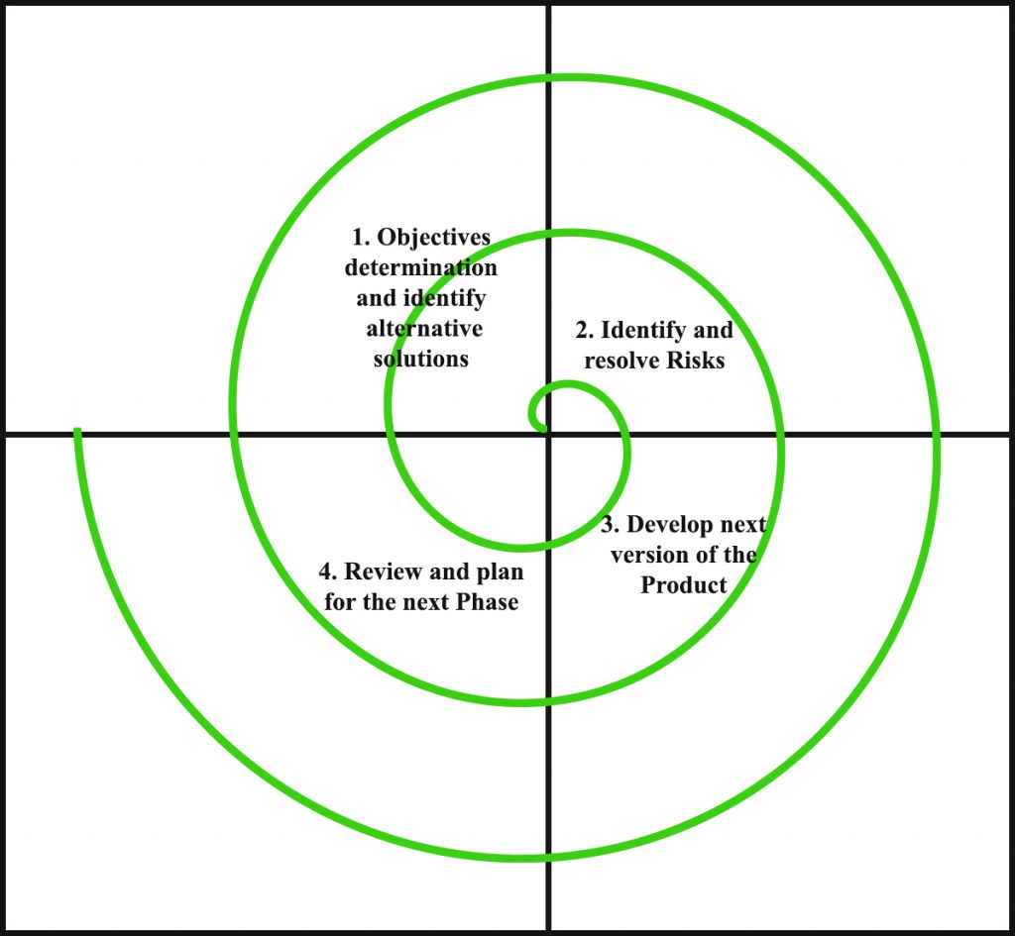
Simplified Spiral Model

Slide 29
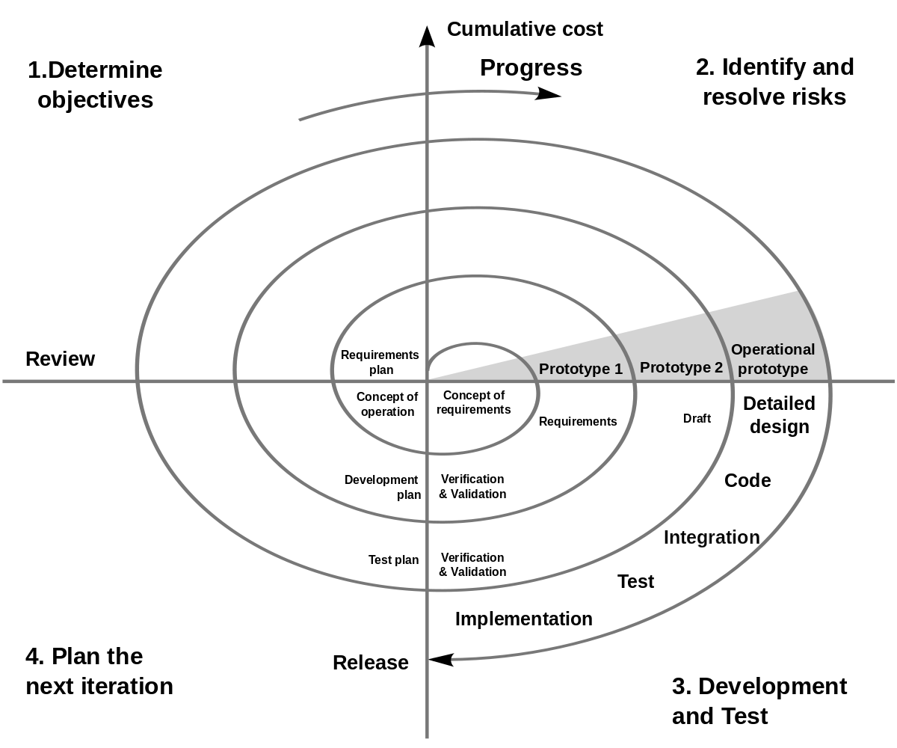
Full Spiral Model

Slide 30
When to use Spiral Methodology?
When project is large
When releases are required to be frequent
When creation of a prototype is applicable
When risk and costs evaluation is important
For medium to high-risk projects
When requirements are unclear and complex
When changes may require at any time
When long term project commitment is not feasible due to changes in economic priorities

Slide 31
Advantages of Spiral Model
Risk Handling: The projects with many unknown risks that occur as the development proceeds, in that case, Spiral Model is the best development model to follow due to the risk analysis and risk handling at every phase.
Good for large projects: It is recommended to use the Spiral Model in large and complex projects.
Flexibility in Requirements: Change requests in the Requirements at later phase can be incorporated accurately by using this model.
Customer Satisfaction: Customer can see the development of the product at the early phase of the software development and thus, they habituated with the system by using it before completion of the total product.

Slide 32
Disadvantages of Spiral Model
Complex: The Spiral Model is much more complex than other SDLC models.
Expensive: Spiral Model is not suitable for small projects as it is expensive.
Too much dependability on Risk Analysis: The successful completion of the project is very much dependent on Risk Analysis. Without very highly experienced experts, it is going to be a failure to develop a project using this model.
Difficulty in time management: As the number of phases is unknown at the start of the project, so time estimation is very difficult.

Slide 33
Agile Process Models
Agile software engineering combines a philosophy and a set of development guidelines
Philosophy
  Encourages customer satisfaction and early incremental delivery of the software
  Small highly motivated project teams
  Informal methods
  Minimal software engineering work products
  Overall development simplicity
Development guidelines
  Stress delivery over analysis and design
  Active and continuous communication between developers and customers

Slide 34
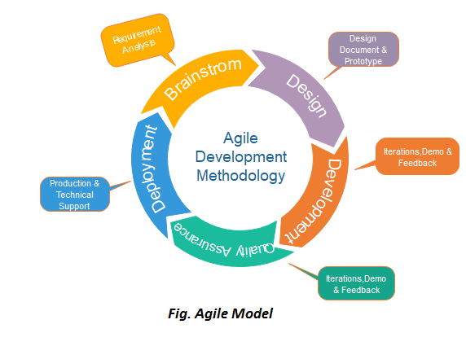

Agile Model

Slide 35
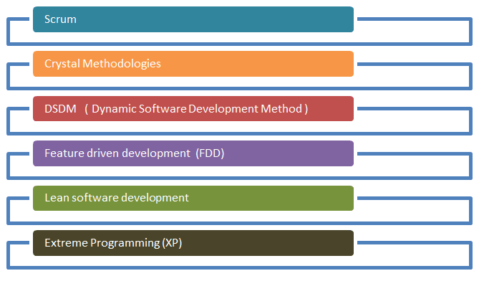
Agile Testing Methods
Notes:
Presentation Required!

Slide 36
Scrum
t
Scrum is an agile method that focuses on managing iterative development rather than specific agile practices.
There are three phases in Scrum.
  The initial phase is an outline planning phase where you establish the general objectives for the project and design the software architecture.
  This is followed by a series of sprint cycles, where each cycle develops an increment of the system.
  The project closure phase wraps up the project, completes required documentation such as system help frames and user manuals and assesses the lessons learned from the project.

Slide 37
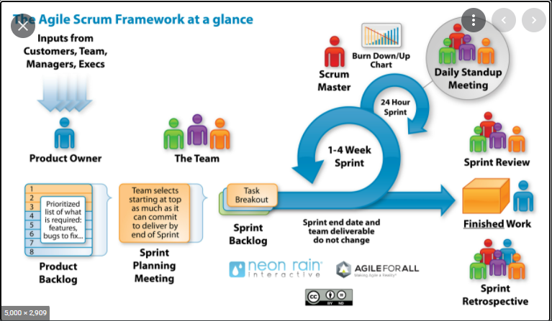

Slide 38
Extreme Programming (XP)
XP is built upon values, principles, and practices, and its goal is to allow small to mid-sized teams to produce high-quality software and adapt to evolving and changing requirements.

Slide 39
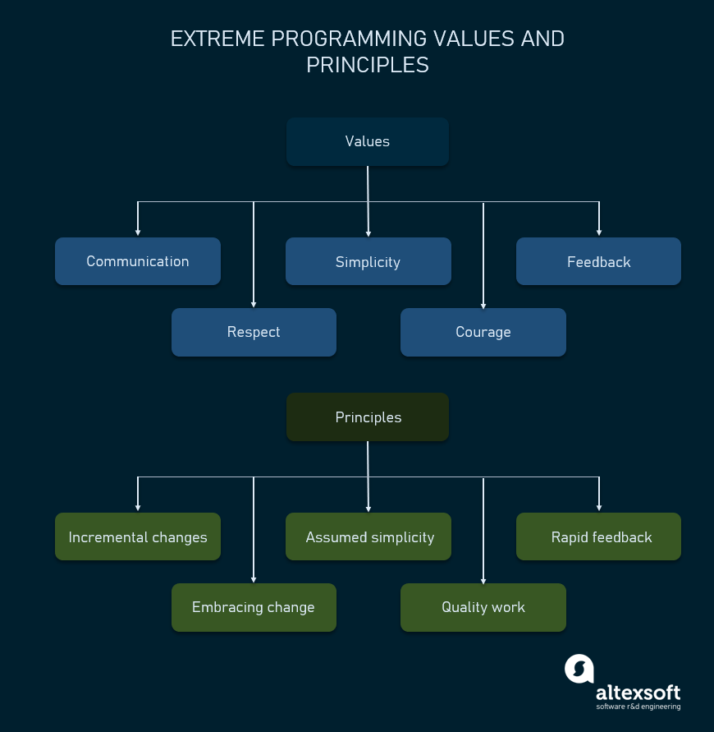

Slide 40
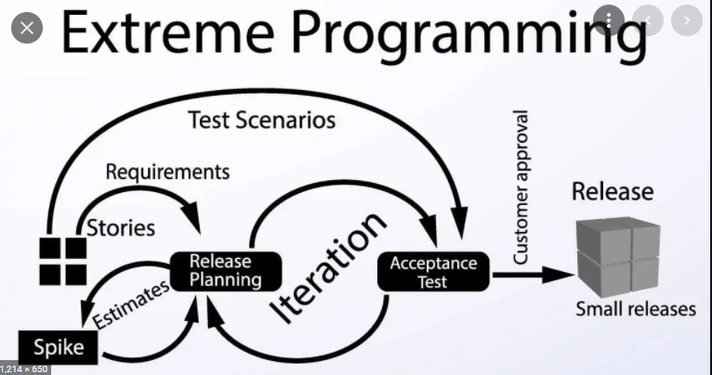

Slide 41
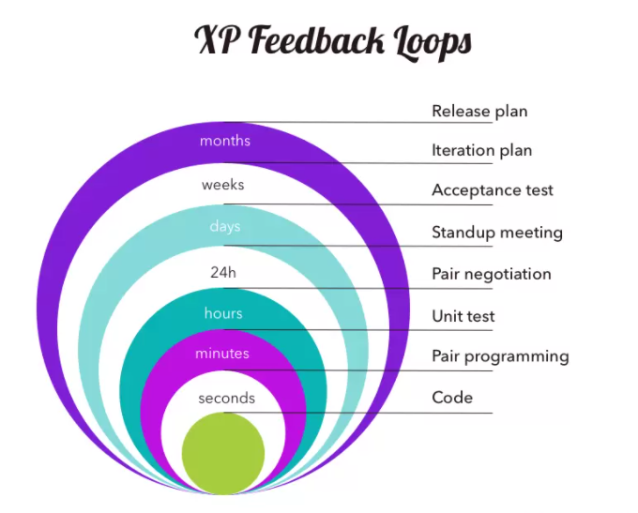

Slide 42
Agile vs. Waterfall Method
Agile Model | Waterfall Model
Agile method proposes incremental and iterative approach to software design | Development of the software flows sequentially from start point to end point.
The agile process is broken into individual models that designers work on | The design process is not broken into an individual models
The customer has early and frequent opportunities to look at the product and make decision and changes to the project | The customer can only see the product at the end of the project
Agile model is considered unstructured compared to the waterfall model | Waterfall model are more secure because they are so plan oriented

Slide 43
Advantages of Agile Model
Customer satisfaction by rapid, continuous delivery of useful software.
People and interactions are emphasized rather than process and tools. Customers, developers and testers constantly interact with each other.
Working software is delivered frequently (weeks rather than months).
Face-to-face conversation is the best form of communication.
Close, daily cooperation between business people and developers.
Regular adaptation to changing circumstances.
Even late changes in requirements are welcomed

Slide 44
Disadvantages of Agile model
In case of some software deliverables, especially the large ones, it is difficult to assess the effort required at the beginning of the software development life cycle.
There is lack of emphasis on necessary designing and documentation.
The project can easily get taken off track if the customer representative is not clear what final outcome that they want.
Only senior programmers are capable of taking the kind of decisions required during the development process. Hence it has no place for newbie programmers, unless combined with experienced resources.

Slide 45
When to use Agile model
When new changes need to be implemented. The freedom agile gives to change is very important. New changes can be implemented at very little cost because of the frequency of new increments that are produced.
To implement a new feature the developers need to lose only the work of a few days, or even only hours, to roll back and implement it.

Slide 46
Unified Process
Unified process is a framework for OO software engineering using UML (Unified Modeling Language)
Unified process (UP) is an attempt to draw on the best features and characteristics of conventional software process models, but characterize them in a way that implements many of the best principles of agile software development.

Slide 47
Unified Process Characteristics
It is an iterative and incremental development framework
It is architecture-centric with major work being done to define and validate an architectural design for most coding is done
It is risk-focused and emphasizes that highest-risk factors be addressed in the earliest deliverables possible
It is use-case and UML model driven with nearly all requirements being documented in one of those forms

Slide 48
Unified Process: Phases
Inception phase
  Encompasses the customer communication and planning activities
  Rough architecture, plan, preliminary use-cases
Elaboration phase
  Encompasses the customer communication and modeling activities
  Refines and expands preliminary use-cases
  Expands architectural representation to include: use-case model, analysis model, design model, implementation model, and deployment model
  The plan is carefully reviewed and modified if needed

Slide 49
Unified Process: Phases
Construction phase
  Analysis and design models are completed to reflect the final version of the software increment
  Using the architectural model as an input develop or acquire the software components, unit tests are designed and executed, integration activities are conducted
  Use-cases are used to derive acceptance tests
Transition phase
  Software is given to end-users for beta testing
  User report both defects and necessary changes
  Support information is created (e.g., user manuals, installation procedures)
  Software increment becomes usable software release

Slide 50
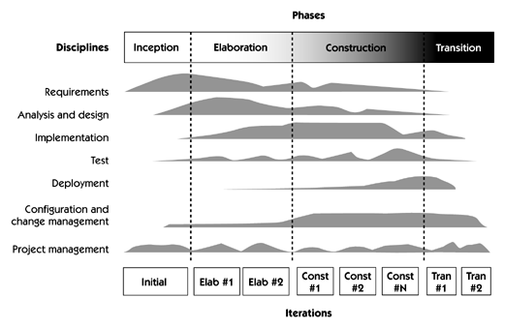
Unified Process Phases

Slide 51
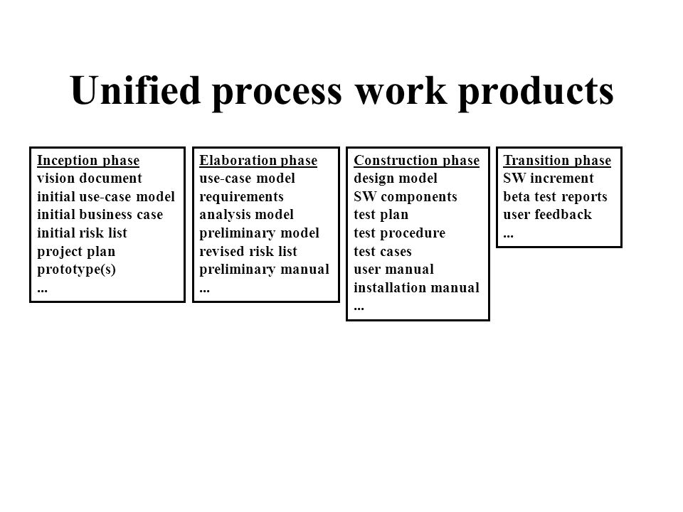

Slide 52
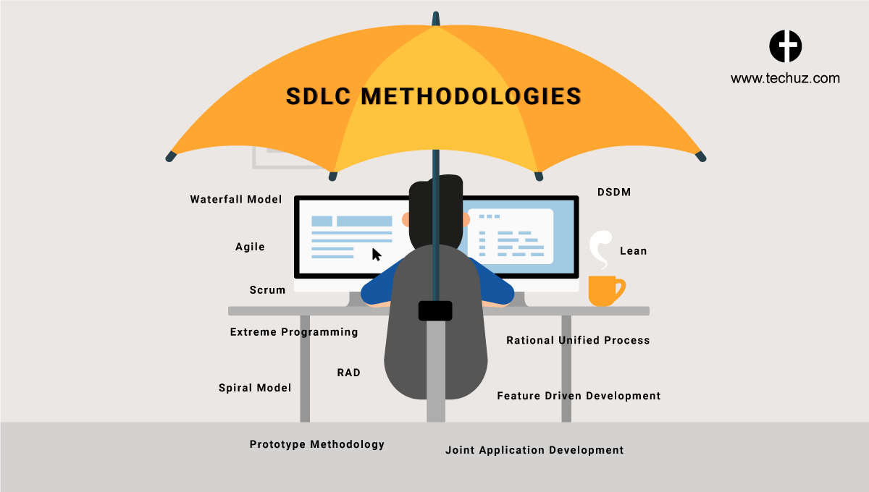
How to Choose between SDLC Methods?

Slide 53
How to Choose between SDLC Methods?
To know which is the best model out of all the different types of SDLC models, it is important to understand that each of these approaches are suitable for different projects, environments, and requirements.
For example, if your project is simple and straightforward with set requirements that do not need to be changed, then Waterfall is best suited for it.
However, if your project is large-scale and consists of multiple components and segments, then choosing Iterative or Spiral methodology would suit your project better.

Slide 54
How to Choose between SDLC Methods?
To answer the question simply, there is no ONE model is best from all the SDLC models discussed.
A preference of one method over the others cannot be determined.
However, to select the right SDLC methodologies, you should know all the types of SDLC models, assess the requirements of all the stakeholders and then decide on a method that best fits your needs.

Slide 55
Criteria for deciding on a model include
Criteria for deciding on a model include
  Product Complexity
  Product Size
  Magnitude of Changes
  Frequency of Changes
  Skills of the Dev Team
  Time constraints
  Access to Users

